Slide 1
Tutor Group Quizzes
Quiz Sample

Slide 2

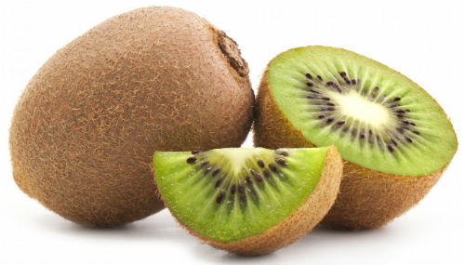
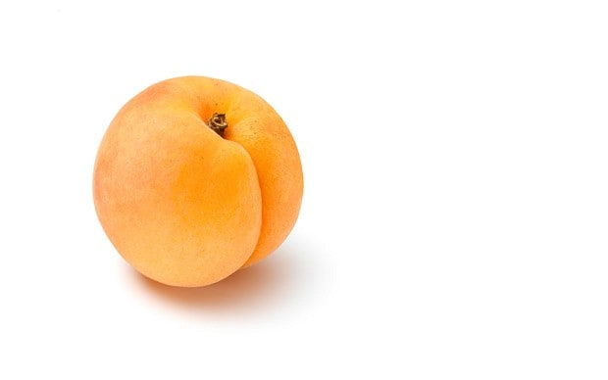
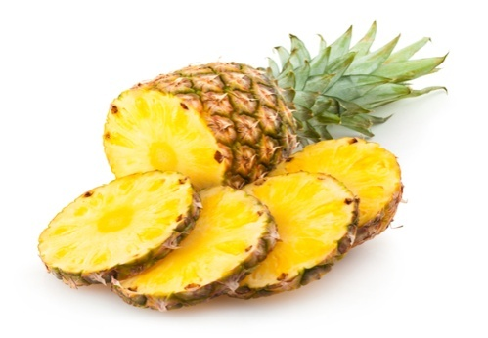
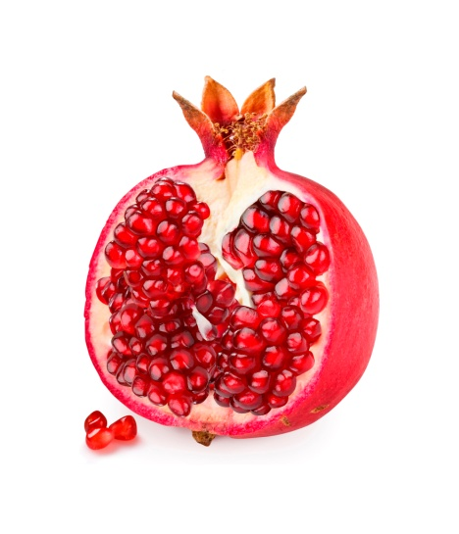
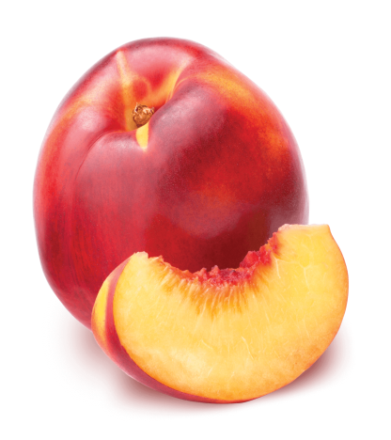
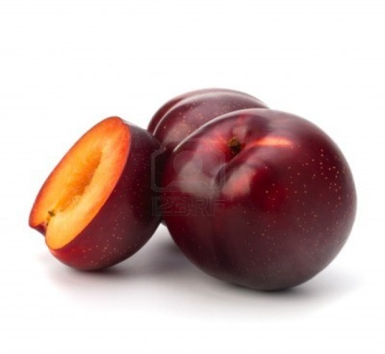
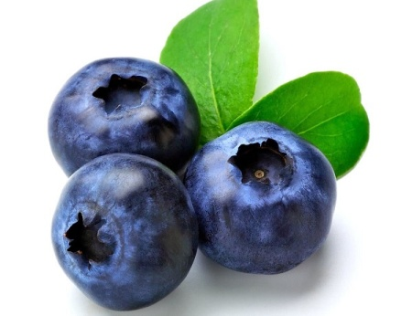
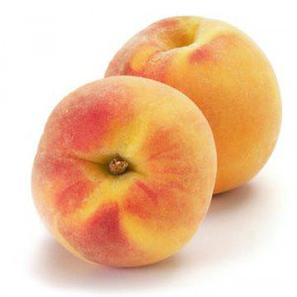
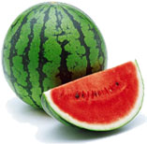
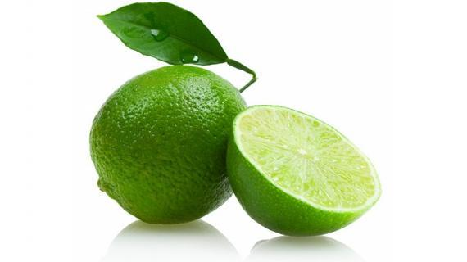
(Quiz 2) Guess the Fruit
Notes:
Answers left to right:
(1) Kiwi fruit (Chinese Gooseberry), (2) Pineapple, (3) Apricot, (4) Pomegranate, (5) Plum, (6) Blueberry, (7) Nectarine, (8) Peach, (9) Water Melon, (10) Lime

Slide 3
(Quiz 2) Guess the Fruit
Kiwi Fruit (Chinese Gooseberry)
Pineapple
Apricot
Pomegranate
Plum
Blueberry
Nectarine
Peach
Water bMelomn
Lime
Notes:
Answers left to right:
(1) Kiwi fruit (Chinese Gooseberry), (2) Pineapple, (3) Apricot, (4) Pomegranate, (5) Plum, (6) Blueberry, (7) Nectarine, (8) Peach, (9) Water Melon, (10) Lime

